Slide 1
One DB Design
Concept and Advantages

Slide 2
One DB Design: Advantages
Every application will have one db design: same tables, to save application data.
Reduce design effort/time
All application data will be in one place. No joins with process db.
Data will be persisted in the form of objects and retrieved in the form of objects. Will follow IBM BPM model. Developers will work with business objects, can dump and pick business objects as-is, will not have to worry about relational mappings.
Changing the tables design, adding/updating/deleting columns based on reporting requirements can be prevented.
Complicated logic of storing and retrieving data because of several columns and tables and their relationships, that could get even more complicated based on reporting requirements will be simplified with this new design.
With same db design, common services, common coach-views are easier(straight forward) to be conceptualized and developed.
Will streamline data retrieval from BPM applications for reporting tools and DataHub. They can develop one automated mechanism to retrieve data across applications versus implementing different data retrieval mechanisms for every BPM application.
Following WM Architectural Principles of Consolidate, Automate, Leverage, Integrate

Slide 3
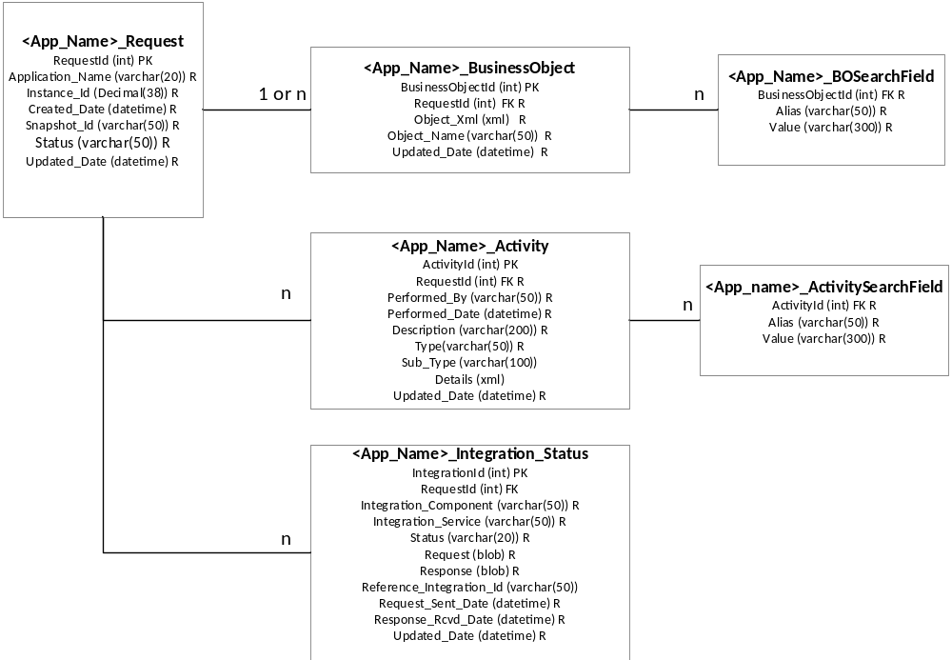
One DB Design: Conceptual Data Model

Slide 4
One DB Design: Table details
Table | <App_Name>_Request | Will contain request information, one row per instance. Will be named by application name like USBI_Request.
Column | DataType | Description.
RequestId | int | Primary Key. UUID.
Application_Name | varchar(20) | Name of the application like USBI
Instance_Id | Decimal(38) | Instance id.
Created_Date | datetime | Date & time when instance started.
Snapshot_Id | varchar(50) | Snapshot id. Will help identify the version of the application Can be used by external applications/services to determine business objects definitions. Business objects may change between different version releases for application, so business objects schema definitions can change between different versions.
Status | varchar(10) | Request Status/ Instance status. Values can be: In-Progress, Failed, Completed.
Updated_Date | datetime | Last updated date of the record. Can be used by external apps/services to determine delta while retrieving data from BPM.

Slide 5
One DB Design: Table details
Table | <App_Name>_BusinessObject | This will keep business objects. Can be 1 to many.
Column | DataType | Description.
BusinessObjectId | int | Primary Key. UUID.
RequestId | int | Request Id. Foreign Key to <App_Name>_Request table.
Object_Xml | clob | Business Object Xml
Object_Name | varchar(50) | Name of the business object.
Updated_Date | datetime | Last updated date of the record. Can be used by external apps/services to determine delta while retrieving data from BPM.
Table | <App_Name>_BOSearchField | This will have the fields in name/value pair through which business object is searchable. Can be used to maintain “where clause” for reports and fields in this table will be indexed.
Column | DataType | Description.
BusinessObjectId | int | Business Object Id. Foreign Key to <App_Name>_BusinessObject table.
Alias | varchar(50) | Name of the search field.
Value | varchar(300) | Value of the search field.

Slide 6
One DB Design: Table details
Table | <App_Name>_Activity | Activities can be saved here. Activity can be Task Completion, Task Started, Approval Service Started, Nigo etc. Activity can be business activity or Technical audit trail.
Column | DataType | Description.
ActivityId | int | Primary Key. UUID.
RequestId | Int | Request Id. Foreign Key to <App_Name>_Request table.
Performed_By | varchar(50) | User who performed the activity
Performed_Date | datetime | Date & time when the activity was performed.
Description | varchar(200) | Will describe what activity was performed. Like “Task was completed”.
Type | varchar(50) | Type of the activity, like Task
Sub_Type | varchar(100) | Sub type of the activity like ApprovalTask
Details | clob | Will contain XML of activity business objects which can have additional fields.
Updated_Date | datetime | Last updated date of the record. Can be used by external apps/services to determine delta while retrieving data from BPM.
Table | <App_Name>_ActivitySearchField | This will have the fields in name/value pair through which activity is searchable. Fields in this table will be indexed.
Column | DataType | Description.
ActivityId | int | Activity Id. Foreign Key to <App_Name>_Activity table.
Alias | varchar(50) | Name of the search field.
Value | varchar(300) | Value of the search field.

Slide 7
One DB Design: Table details
Table | <App_Name>_Integration_Status | Will maintain the status for integration calls.
Column | DataType | Description.
IntegrationId | int | Primary Key. UUID.
RequestId | int | Request Id. Foreign Key to <App_Name>_Request table.
Integration_Component | varchar(50) | Integration component. Like SEI.
Integration_Service | varchar(50) | Integration service. Like getAccountInformation.
Status | varchar(20) | Status of the integration. Values can be Successful, Failed OR InProgress.
Request | clob | Request sent.
Response | clob | Response received.
Reference_Integration_Id | varchar(50) | Id returned by external service. Like Filenet_Id
Request_Sent_Date | datetime | Date & time when call was made.
Response_Rcvd_Date | datetime | Date & time when response was received.
Updated_Date | datetime | Last updated date of the record. Can be used by external apps/services to determine delta while retrieving data from BPM.

Slide 8
One DB Design: Common Services/ Objects/ Coach Views
saveBusinessObject(BusinessObject, Key/Value searchFieldMap): Parameter will be business object of type “Any”, that will be saved along with search Fields passed through name/value pair map.
getBusinessObject(Key/Value searchFieldMap): Will return business object of type “Any”, using search criteria specified by searchFieldMap.
saveActivity(Activity): Will save activity
saveTaskCompletion(Task): Will call saveActivity by setting activity type = Task
saveAuditTrail(AuditTrail): Will call saveActivity by setting activity type = AuditTrail
saveBusinessActivity(BusinessActivity): Will call saveActivity by setting activity type = BusinessActivity
saveComment(Comment): Will call saveActivity by setting activity type = comment.
Similarly there can be additional common services like: saveNIGOReason, saveApproval, getAuditTrail, getAuditTrailList, getComment, getComments, getBusinessActivity, getTaskCompletionList, getActivity
Also we can have common objects with their fields defined. Like Activity, Task, Comment, NIGO, Approval, BusinessActivity, AuditTrail
Common services and common objects will feed into common coach views like NIGO_CoachView, Approval_CoachView, Comment_CoachVeiw, AuditTrail_CoachView, TaskCompletionHistory_CocahView, NIGO_HistoryCoachView, ApprovalHistory_CoachView, CommentsTrail_CoachView, BusinessActivityTrail_CoachView

Slide 9
One DB Design: Guidelines
At minimum have one object for the request/instance, can be called as request object
Save request object at the start and completion of the BPD
Save Request after every Task completion.
Save Task completion activity after every Task completion.
For integration calls, save information after integration call is complete i.e. in both cases if integration call is failed or successful. Please note if response doesn’t come back then there should be time-out mechanism after which integration status can be saved as failed.

Slide 10
Q & A

